Slide 1
Kinetic Molecular Theory
The microscopic view
§13.8–9

Slide 2
The Idea
Matter is made of molecules
Molecules are in perpetual motion
Kinetic energy = ½ k_{B}T per mode of motion
k_{B} = Boltzmann constant = 1.38 × 10^{–23} J/K

Slide 3
Temperature and Energy
Temperature is proportional to average molecular translational kinetic energy
Translation = moving through space
Excludes rotation and vibration
Different modes rapidly equilibrate
There are three translational modes
The three dimensions of space

Slide 4
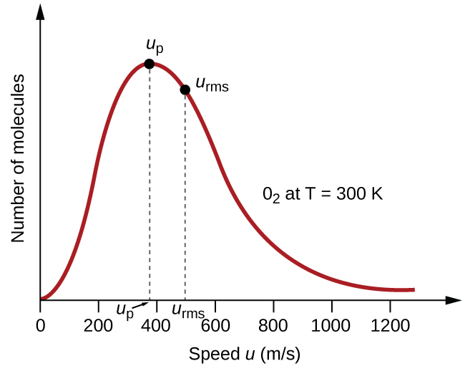
Distribution of Speeds
Most probable speed
Average speed
Higher speeds for higher T
Slower speeds for heavier molecules
From Openstax
For O₂ at 300 K

Slide 5
Ideal Gas Model Shortcomings
Does not address interaction behavior
condensation
mean-free path
sound transmission
slow diffusion

Slide 6
Vapor Pressure
Molecules in liquids or solids may detach and enter the vapor phase
Evaporation
Sublimation
Equilibrium vapor pressure depends on temperature
Higher T ⇒ higher vapor pressure

Slide 7
Collecting a Gas
In chemistry, gases are often produced from a solution
The gas contains solvent vapor at its saturation pressure

